Slide 1



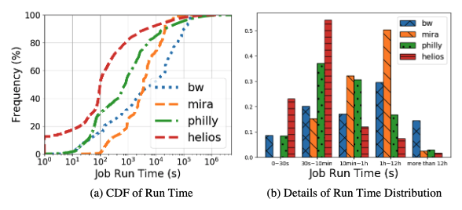

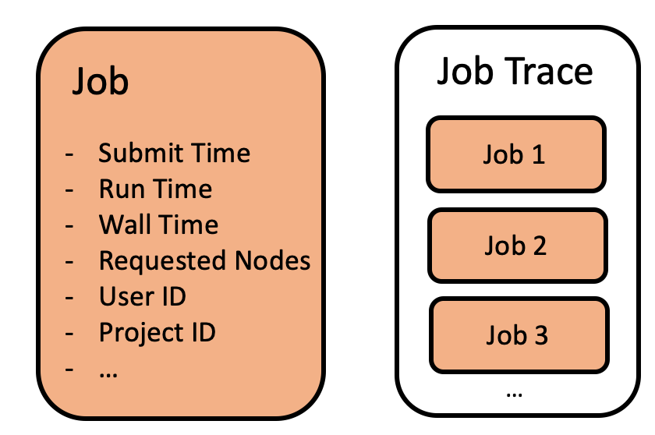
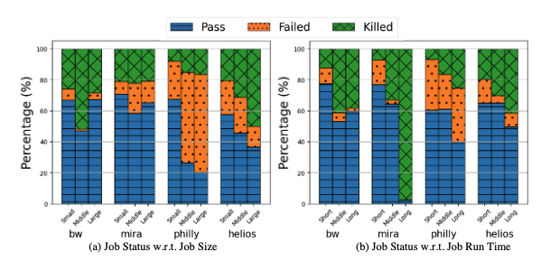
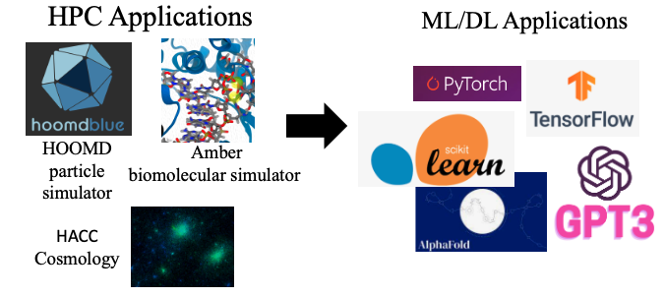
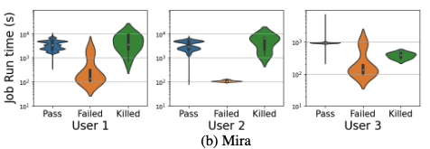
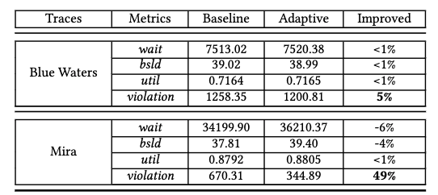
Optimizing Resource Management for Machine Learning Workloads in High-Performance Clusters
Di Zhang, UNC Charlotte
Dong Dai, DIRLAB
Introduction
Collected Data
Results
Conclusions
About High-Performance Clusters…
HPC systems are traditionally optimized for long-term, resource-heavy scientific simulations.
An increasing integration of DL applications presents new challenges due to their different characteristics:
Heterogeneous resource use, leveraging both CPUs and GPUs.
High cancellation rate due to feedback-driven exploration.
The rising popularity of DL in HPC is significantly impacting job scheduling.
It's crucial for the HPC community to understand and adapt to these changes to maintain system performance and efficiency.
Four Job Traces
How does Job Trace look like?
7 Takeaways:
Conclusions
A cross-system analysis was conducted on four real-world clusters, including classic HPC, classic DL, and hybrid setups, to understand the impact of emerging DL workloads on HPC scheduling.
Seven key takeaways were identified, revealing notable differences and similarities among the clusters.
These insights will guide the design of more efficient job schedulers for future HPC systems.
Two use case studies were introduced - job run time prediction and adaptive relaxed backfilling - to enhance existing job scheduling.
Future Work
All data processing logic and simulator will be publicly accessible and online analysis services will be provided, helping researchers design more efficient HPC schedulers in the future.
Mira (ANL)
Blue Waters (NCSA)
Philly (Microsoft)
Helios (Sensetime)
(Job Run Time) Takeaway 1: DL jobs tend to be shorter than traditional HPC jobs
Characteristic Aspects
(Job Failure) Takeaway 2: the larger and longer jobs present higher failure rates across the systems
…
Analyzing Key Attributes
Job Geometries Characterization
Job Run Time
Job Arrival Patterns
System Utilization and Resource Occupation
Job Waiting Time
Job Failure Characterization
Job Failures Distribution
Correlation between Job Failure and Job Geometries.
Users’ Behaviors Characterization
Users’ Repeated Behaviors
Users’ Submission Behaviors.
Correlation between Per-User Job Run Time and Job Statuses.
(User Behavior) Takeaway 7: the elapsed time of users’ jobs, can be used to predict job runtimes and be utilized further for better scheduling efficiency
Objectives
Research Opportunities:
References
Goals
Compare and contrast the characteristics of traditional HPC jobs and DL jobs to gain a comprehensive understanding of their similarities and differences.
Identify novel opportunities in resource management to effectively cater to the demands of these emerging workloads.
[1] Zhang, Di, et al. "RLScheduler: an automated HPC batch job scheduler using reinforcement learning." SC20: International Conference for High Performance Computing, Networking, Storage and Analysis. IEEE, 2020.
[2] Zhang, Di, Dong Dai, and Bing Xie. "SchedInspector: A Batch Job Scheduling Inspector Using Reinforcement Learning." Proceedings of the 31st International Symposium on High-Performance Parallel and Distributed Computing. 2022.
Benefit on leveraging user behaviors in relaxed backfilling in HPC scheduling

